Slide 1
Infrastructure
EPFL Software Engineering

Slide 2




Slide 3



Slide 4


Slide 6
Objectives
Contrast old and new version control systems
Organize your code with Git
Write useful descriptions of code changes
Avoid mistakes with continuous integration

Slide 7
What is version control?

Slide 8

Vocabulary
Repository

Slide 9
Pull

Slide 10
Push

Slide 11
Commit

Slide 12


Commit
Who?
What?
When?
Why?

Slide 13

Revert

Slide 14


History

Slide 15


1st generation
A.txt
A.txt
B.txt

Slide 16

1st generation

Slide 17


Slide 18
Conflict

Slide 19

Merge

Slide 20
Branches

Slide 21
Branches
v1.0
Bugfix
Main

Slide 22

Workflow

Slide 23
“Squash”

Slide 24
“Cherry pick”
v1.0
Main

Slide 25



2nd generation
A.txt
A.txt

Slide 26
Centralization

Slide 27
3rd generation: Decentralization
=

Slide 28
3rd generation

Slide 30
3rd generation in practice

Slide 31



3rd generation in practice
Git logo by Jason Long; Mercurial logo by Cali Mastny and Matt Mackall; Bazaar logo by the Bazaar developers

Slide 32





Slide 33
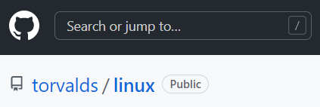

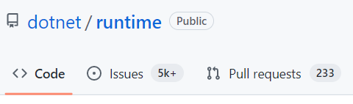

Slide 34
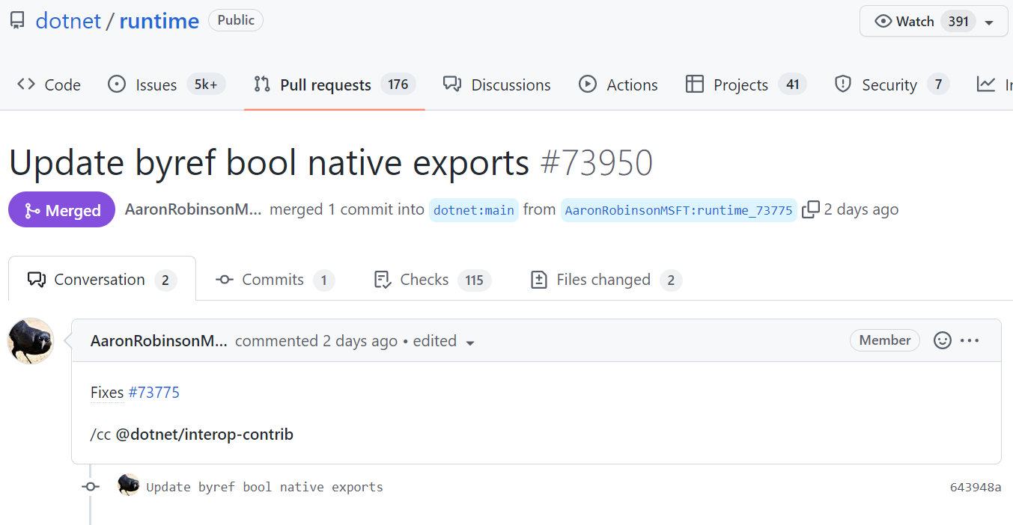
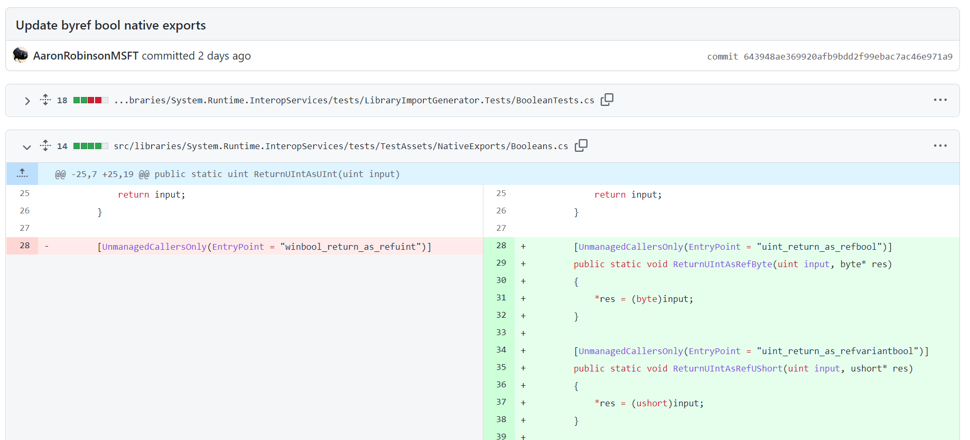
https://github.com/dotnet/runtime/pull/73950

Slide 35
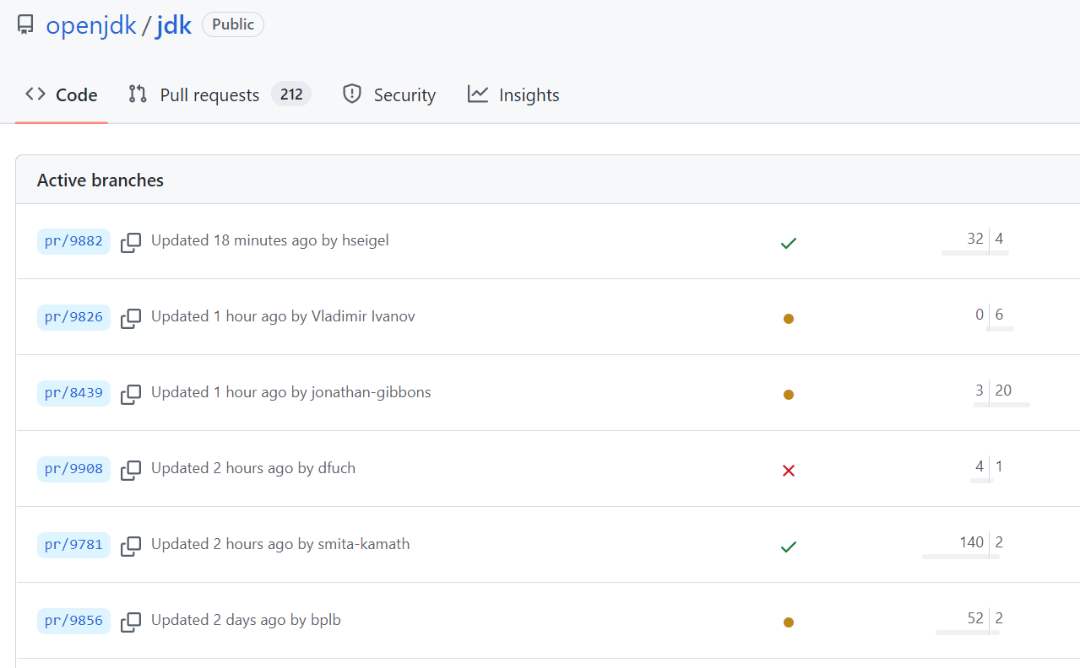
https://github.com/openjdk/jdk/branches/active

Slide 36
Windows on Git (2017)
3.5 million files
300 GB repo
4,000 engineers
4,000 branches
8,000 pushes / day
https://devblogs.microsoft.com/bharry/the-largest-git-repo-on-the-planet/

Slide 37
Reminder: Prerequisites
Install Git
Create a GitHub account
Configure an SSH key

Slide 38
How does one use Git?

Slide 39
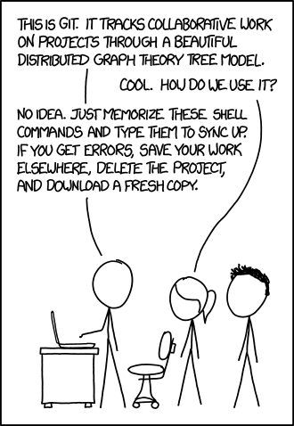
https://xkcd.com/1597/

Slide 40
Git
$ git status

Slide 41
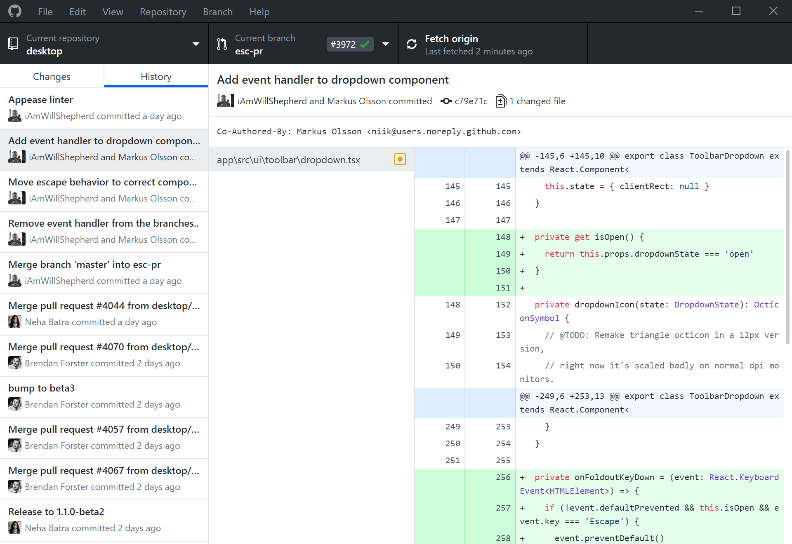
GitHub Desktop

Slide 42
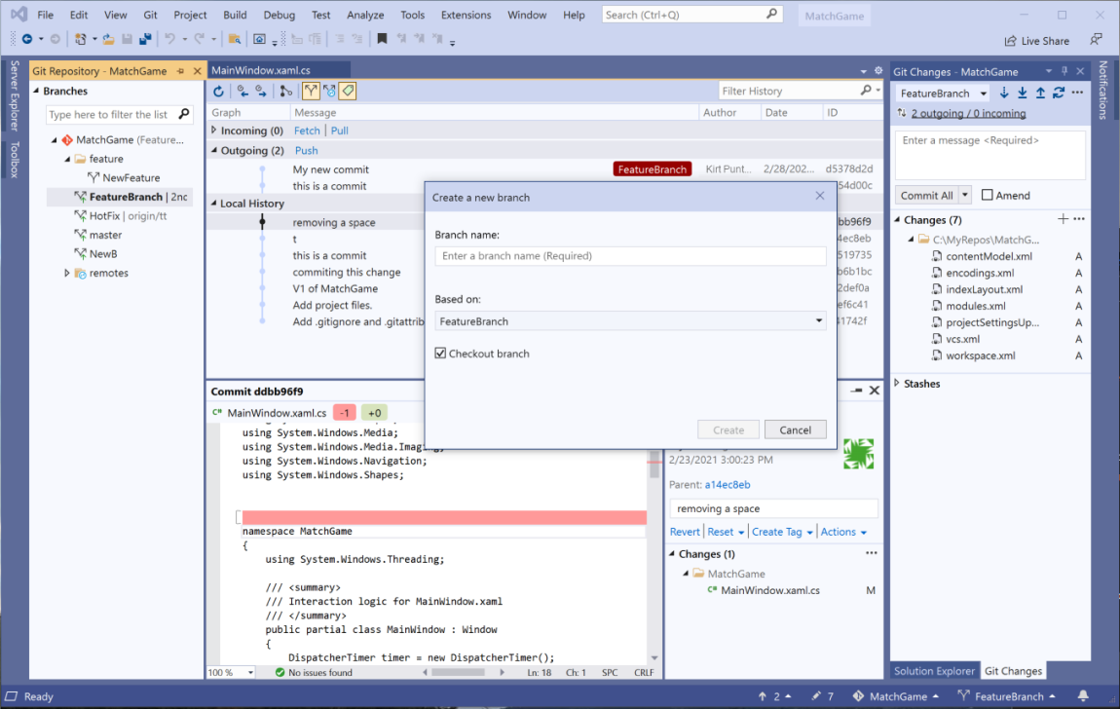
Visual Studio

Slide 43
Interactive exercise objectives
Create a repository
Make some changes
Publish it online

Slide 44
~$ mkdir example
~$ cd example
~/example$ git init
Initialized empty Git repository in ~/example/.git/

Slide 45
$ echo 'Hello' > hello.txt

Slide 46
$ git status
...
Untracked files:
hello.txt

Slide 47
$ git add -A
$ git status
...
Changes to be committed:
new file: hello.txt

Slide 48
$ git commit
[...] Initial commit.
1 file changed, 1 insertion(+)
create mode 100644 hello.txt

Slide 49
$ echo 'Goodbye' >> hello.txt

Slide 50
$ git diff
diff --git a/hello.txt b/hello.txt index e965047..c86756d 100644 --- a/hello.txt +++ b/hello.txt @@ -1 +1,2 @@ Hello +Goodbye

Slide 51
$ git add -A

Slide 52
$ git diff

Slide 53
States of changed files
Modified
Staged
Committed

Slide 54
$ git diff --staged
diff --git a/hello.txt b/hello.txt index e965047..c86756d 100644 --- a/hello.txt +++ b/hello.txt @@ -1 +1,2 @@ Hello +Goodbye

Slide 55
$ git commit -m 'Say goodbye'
[...] Say goodbye
1 file changed, 1 insertion(+)

Slide 56
$ git switch -c feature/today
Switched to a new branch 'feature/today'

Slide 57
Edit the file
“Hello” → “Hello today”

Slide 58
$ git add -A && git commit -m 'Add time'
[...] Add time
1 file changed, 1 insertion(+), 1 deletion (-)

Slide 59
What about commit -a ?
Adds modified files only!

Slide 60
$ git branch
* feature/today
main

Slide 61
$ git switch main
Switched to branch 'main'
Notes:
OR MASTER !!!

Slide 62
Edit the file differently
“Hello” → “Hello everyone”

Slide 63
$ git add -A && git commit -m 'Add folks'
[...] Add folks
1 file changed, 1 insertion(+), 1 deletion (-)

Slide 64
$ git merge feature/today
Auto-merging hello.txt
CONFLICT (content): Merge conflict in hello.txt
Automatic merge failed; fix conflicts and then commit the result.

Slide 65
$ cat hello.txt
<<<<<<< HEAD Hello everyone ======= Hello today >>>>>>> feature/today Goodbye

Slide 66
$ git add -A && git commit -m 'Merge'
[...] Merge

Slide 67
$ git commit --amend -m 'Merge branch'
[...] Merge branch
Date: ...

Slide 68
$ echo 'asdf' >> hello.txt

Slide 69
$ git restore hello.txt

Slide 70
$ echo 'asdf' > mistake.txt

Slide 71
$ git clean -fdn
$ git clean -fd

Slide 72
$ mkdir folder
$ git status
...
nothing to commit, working tree clean

Slide 73

Create a GitHub repo + push
Public or private Without creating files (readme, etc.)
Follow the GitHub instructions “…or push an existing repository from the command line”

Slide 74
$ echo 'See ya' >> hello.txt

Slide 75
$ git add -A && git commit -m 'Add bye'
[...] Add bye
1 file changed, 1 insertion(+)

Slide 76
$ git push
...

Slide 77
$ git pull
Already up to date

Slide 78
Pull is per branch
git pull
git pull
git switch ...

Slide 79
$ git switch -c example
$ git push -u origin example
...

Slide 80
$ echo '1234' > password.txt

Slide 81
$ echo 'password.txt' >> .gitignore

Slide 82
$ git status
...
Untracked files:
.gitignore

Slide 83

Creating a fork
github.com/sweng-example/hello

Slide 84
Branch vs fork
Branches
Fork
Branches

Slide 85

$ cd ~
$ git clone git@github.com:...
Cloning into 'hello'...
...

Slide 86
Make a change
Add your name
Commit
Push

Slide 87
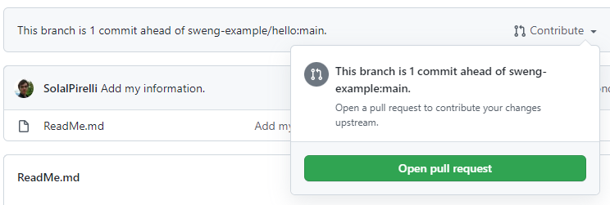
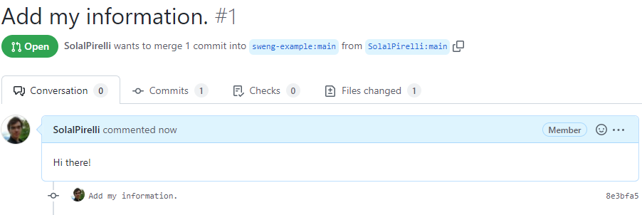
Open a pull request

Slide 88
Get used to Git
Use it, use it, use it…

Slide 89
Advanced git features
bisect, blame, cherry-pick, stash, …
Read the docs!

Slide 90
How does one write good commit messages?

Slide 91





Goal

Slide 92
Audience
Reviewers
Colleagues
Future You

Slide 93
Typical format
1-line summary
<blank line>
Details as many as needed

Slide 94
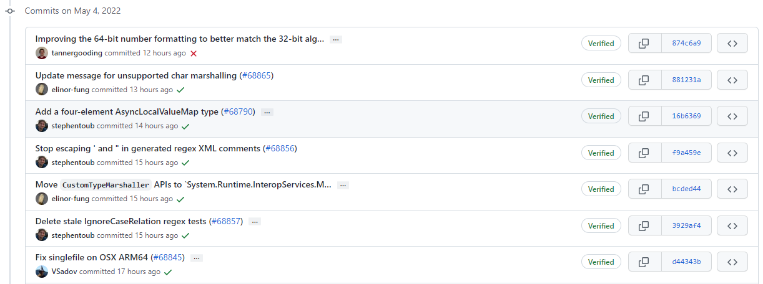
Extract of github.com/dotnet/runtime commits

Slide 95
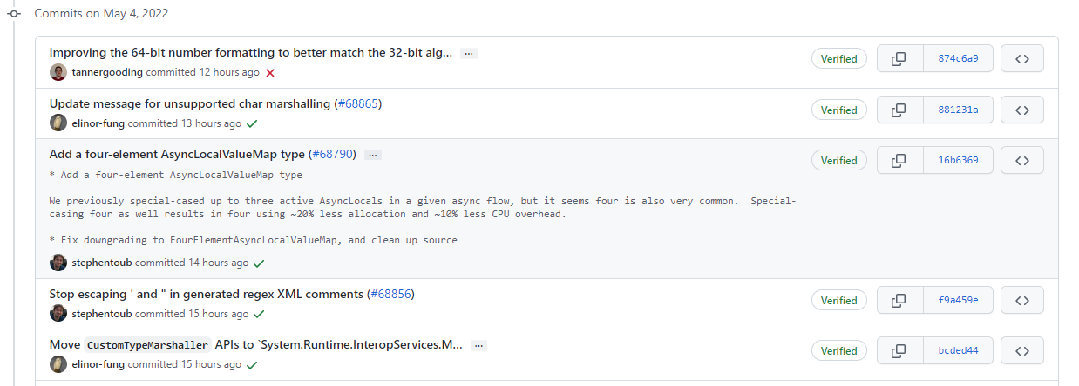
Extract of github.com/dotnet/runtime commits

Slide 96
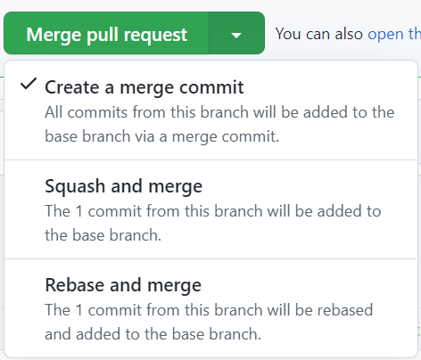

Slide 97
$ git log --oneline
3336497 (origin/main) Say bye 64bbf47 Merge branch 334d702 Add people ca26664 (feature/today) Add time 905cb6e Initial commit.

Slide 98
Good summary: imperative
“Fix bug #145”
“Add an HD version of the wallpaper”
“Support Unicode 14.0”

Slide 99
Details
What?
Why?
Not how

Slide 100
How can we avoid merging buggy code?

Slide 101
Idea: Merge only code that…
…compiles
…is clean
…is tested
…etc.

Slide 102
IDEs
Build
Code analysis
Compile
Run
Run tests

Slide 103
Problem
Humans make mistakes…

Slide 104



Build systems
MSBuild

Slide 105
Build as code
<Project Sdk="Microsoft.NET.Sdk"> <ItemGroup>
<PackageReference Include="Microsoft.Z3" Version="4.10.2" />
</ItemGroup> </Project>

Slide 106



Where to build?

Slide 107
Machine as code
FROM node:12-alpine
RUN apk add python g++ make
COPY . .
RUN yarn install
CMD ["node", "src/index.js"]
EXPOSE 3000

Slide 108




Machines as code

Slide 109

“Machine” ?
ZZZ

Slide 110
Virtual machines
VM
VM
VM
…
OS
OS
OS
Kernel
Kernel
Kernel
Host OS
Host kernel

Slide 111
Containers
OS
OS
OS
…
Host OS
Host kernel

Slide 112

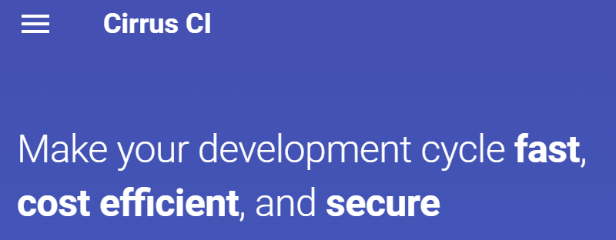

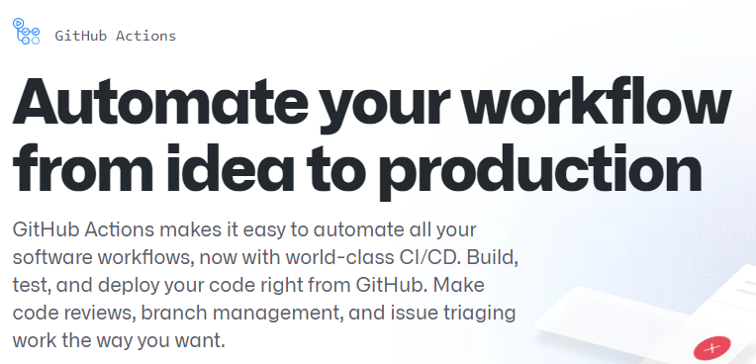
“Continuous integration”

Slide 113
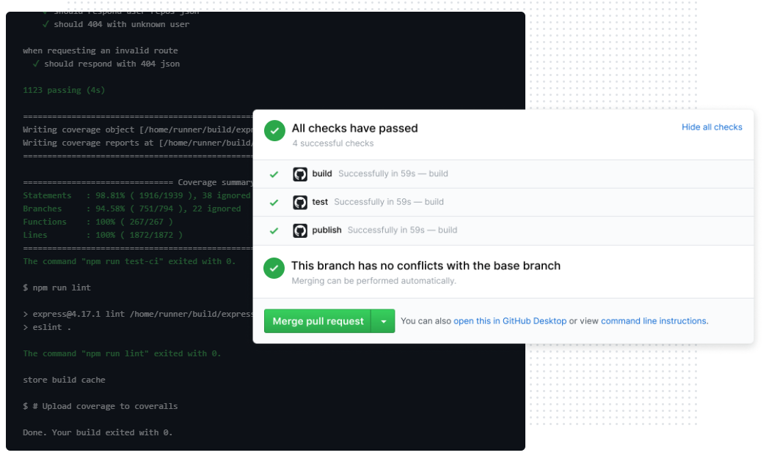
https://github.com/features/actions

Slide 114
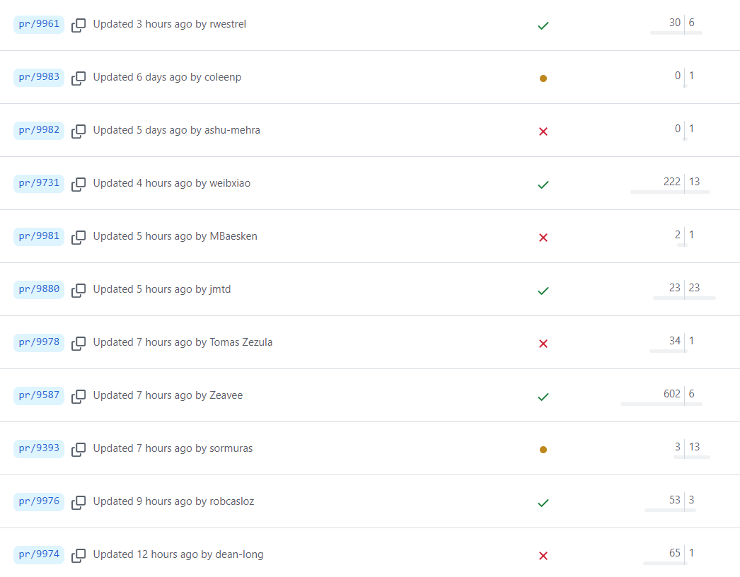
https://github.com/openjdk/jdk/branches/all

Slide 115
Outcome
“There exists a machine on which
your code [succeeds | fails]”

Slide 116
“It works on my machine”
¯\_(ツ)_/¯

Slide 117

Differences
Yes
Yes
No

Slide 118
Exercise: Add GitHub Actions
Add .github/workflows/example.yml:
on: push jobs: example: runs-on: ubuntu-latest steps: - uses: actions/checkout@v3 - run: echo "Hello!"
Notes:
10min max, leave 1min for end

Slide 119
“Operations”
Version control
Continuous integration
Continuous deployment
…

Slide 120
Dev
Operations
DevOps

Slide 121
Summary
Version control systems: 1st, 2nd, 3rd generation
Git: Basics, good commit messages
Continuous integration: Build systems, VMs, containers

